Slide 1
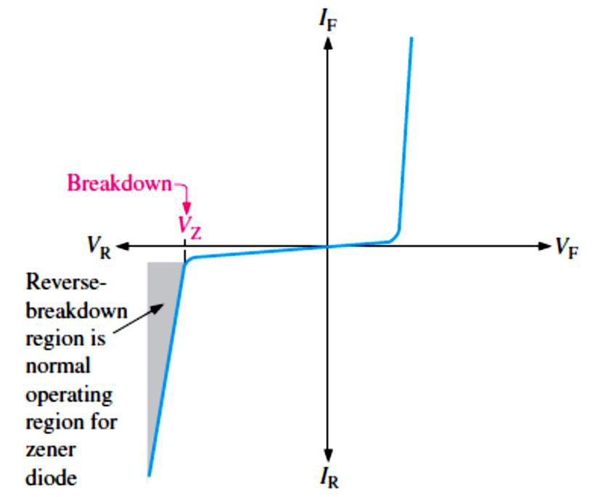
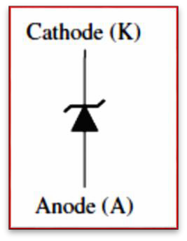
Lecture 3: Special-Purpose Diodes
In this Lecture, we will describe the characteristics and analyze the operation of several other types of diodes that are designed for specific applications, including the zener, varactor (variable capacitance), light-emitting, photo, laser, Schottky, tunnel, pin, step-recovery, and current regulator diodes.
3.1 The Zener Diode
The symbol for a zener diode is shown in Figure 3-1. Instead of a straight line representing the cathode, the zener diode has a bent line that reminds us of the letter Z (for zener).
A zener diode is a silicon pn junction device that is designed for operation in the reverse- breakdown region.
The breakdown voltage of a zener diode is set by carefully controlling the doping level during manufacture.
From the discussion of the diode characteristic curve, when a diode reaches reverse breakdown, its voltage remains almost constant even though the current changes drastically,
and this is the key to zener diode operation.
This volt-ampere characteristic is shown again in Figure 3-2 with the normal operating region for zener diodes shown as a shaded area.
There are two reverse breakdown mechanisms in a zener diode: avalanche breakdown and
zener breakdown.
Avalanche breakdown occurs in both rectifier and zener diodes at a sufficiently high reverse voltage (when zener breakdown voltage �_{Z} > 5 V).
FIGURE 3-1: Zener diode symbol.
FIGURE 3-2: General zener diode V-I characteristic.

Slide 2
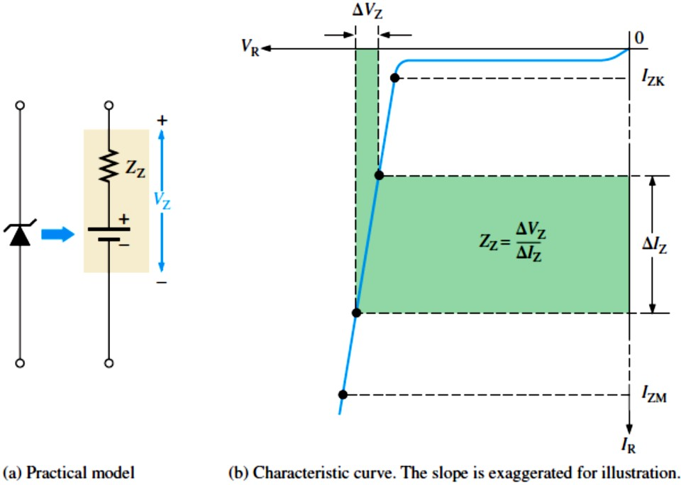
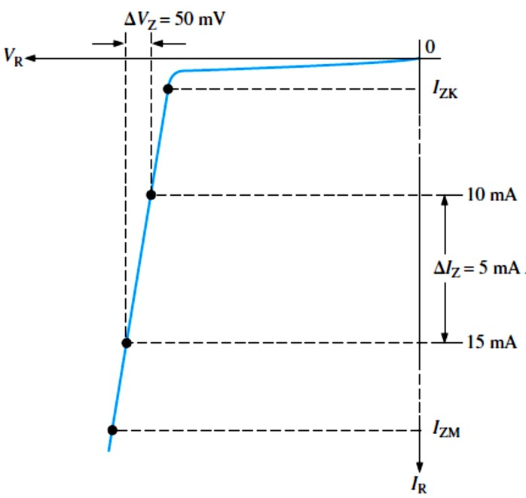
Zener breakdown occurs in a zener diode at low reverse voltages (when �_{Z} < 5 V).
A zener diode maintains a nearly constant voltage across its terminals over a specified range of zener currents (i.e. acts as a voltage regulator).
Zener diodes are commercially available with breakdown voltages from less than 1 V to more than 250 V.
  Figure 3-3(a) represents the practical model of a zener diode. A change in zener current (∆𝐼_{Z}) produces a small change in zener voltage (∆�_{Z}), as illustrated in Figure 3-3(b). The
ratio of ∆�_{Z} to ∆𝐼_{Z} is the impedance (resistance):
∆�_{Z}
𝑍_{Z} = _{∆𝐼}
Equation 3– 1
Z
FIGURE 3-3: Practical zener diode equivalent circuit and the characteristic curve illustrating 𝑍_{Z}.
EXAMPLE 3-1: A zener diode exhibits a certain change in �_{Z} for a certain change in 𝐼_{Z} on a portion of the linear characteristic curve between 𝐼_{𝑍�} and 𝐼_{𝑍M} as illustrated in Figure 3-4. What is the zener impedance?
FIGURE 3-4
Solution 𝑍_{Z} = ∆�_{Z}⁄∆𝐼_{Z} = 50 mV⁄5 mA = 10 Ω

Slide 3
The formula for calculating the change in zener voltage for a given junction temperature change, for a specified temperature coefficient, is
∆�_{Z} = �_{Z} × 𝑇�× ∆𝑇
Equation 3– 2
where �_{Z} is the nominal zener voltage at the reference temperature of 25℃, 𝑇�is the temperature coefficient, and ∆𝑇is the change in temperature from the reference temperature.
A positive 𝑇�means that the zener voltage increases with an increase in temperature or decreases with a decrease in temperature.
A negative 𝑇𝐶means that the zener voltage decreases with an increase in temperature or increases with a decrease in temperature.
In some cases, the temperature coefficient is expressed in mV/℃ rather than as %/℃. So
∆�_{Z} = 𝑇�× ∆𝑇
Equation 3– 3
EXAMPLE 3-2: An 8.2 V zener diode (8.2 V at 25℃) has a positive temperature coefficient of 0.05%/℃.What is the zener voltage at 60℃?
Solution The change in zener voltage is
∆�_{Z} = �_{Z} × 𝑇�× ∆𝑇= (8.2 V)(0.05%/℃)(60℃ − 25℃)= (8.2 V)(0.0005/℃)(35℃)=144 mV
Notice that 0.05%/℃ was converted to 0.0005/℃. The zener voltage at 60℃ is
�_{Z} + ∆�_{Z} = 8.2 V + 144mV = 8.34 V
Zener Power Dissipation and Derating: Zener diodes are specified to operate at a maximum power called the maximum dc power dissipation, �_{D(max)}. The dc power dissipation is
�_{D} = �_{Z}𝐼_{Z}
Power Derating The maximum power dissipation of a zener diode is typically specified for temperatures at or below a certain value (25℃, for example). Above the specified temperature, the maximum power dissipation is reduced according to a derating factor. The derating factor is expressed in mW/℃. The maximum derated power is:
�D(derated) ^{= �}D(max) ^{− (mW⁄℃)∆𝑇}
EXAMPLE 3–3: A certain zener diode has a maximum power rating of 400 mW at 50℃ and a derating factor of 3.2 mW⁄℃. Determine the maximum power the zener can dissipate at a temperature of 90℃.
Solution
𝑃_{D(derated)} = 𝑃_{D(max)} − (mW⁄℃)∆𝑇= 400 mW − (3.2 mW⁄℃)(90℃ − 50℃)
= 400 mW − 128 mW = 272 mW

Slide 4
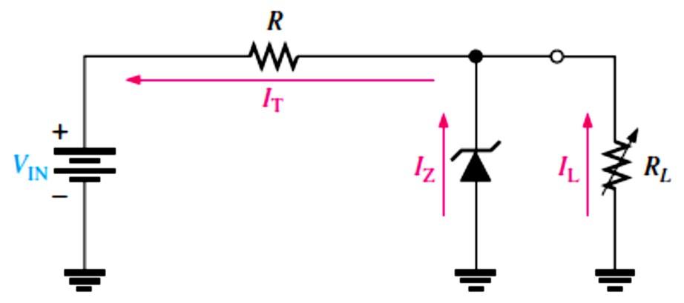
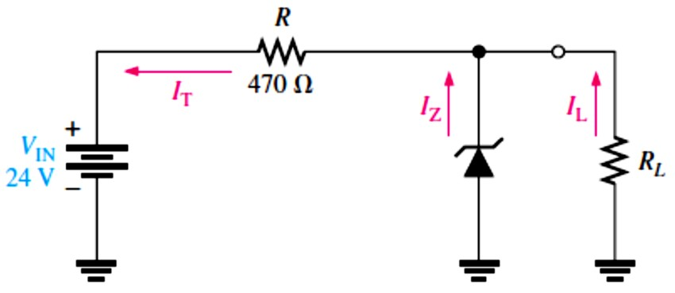
3.2 Zener Diode Applications
Zener diodes are used as voltage references, regulators, and limiters or clippers.
Zener Regulation with a Variable Input Voltage: Zener diode regulators can provide a reasonably constant dc level at the output, but they are not particularly efficient. For this reason, they are limited to applications that require only low current to the load.
Zener Regulation with a Variable Load: Figure 3-5 shows a zener voltage regulator with a
variable load resistor across the terminals. The zener diode maintains a nearly constant voltage across 𝑅� as long as the zener current is greater than 𝐼_{ZK} and less than 𝐼_{ZM}.
FIGURE 3-5: Zener regulation with a variable load.
From No Load to Full Load: When the output terminals of the zener regulator are open (𝑅� = ∞), the load current is zero and all of the current is through the zener; this is a no-load condition.
  When a load resistor (𝑅� ) is connected, part of the total current is through the zener and part through 𝑅� . The total current through R remains essentially constant as long as the
zener is regulating. As 𝑅� is decreased, the load current 𝐼� , increases and 𝐼_{Z} decreases. The zener diode continues to regulate the voltage until 𝐼_{Z} reaches its minimum value, 𝐼_{ZK}. At
this point the load current is maximum, and a full-load condition exists. The following
example will illustrate this.
EXAMPLE 3-6: Determine the minimum and the maximum load currents for which the zener diode in Figure 3-6 will maintain regulation. What is the minimum value of 𝑅� that can be used?
�_{Z} = 12 V, 𝐼_{ZK} = 1 mA, and 𝐼_{ZM} = 50 mA. Assume an ideal zener diode where 𝑍_{𝑍}= 0 Ω and �_{Z} remains a constant 12 V over the range of current values, for simplicity.
FIGURE 3-6
Solution When 𝐼_{L}= 0 A (𝑅� = ∞),
𝐼_{Z} is maximum and equal to the total circuit current 𝐼_{T}.

Slide 5
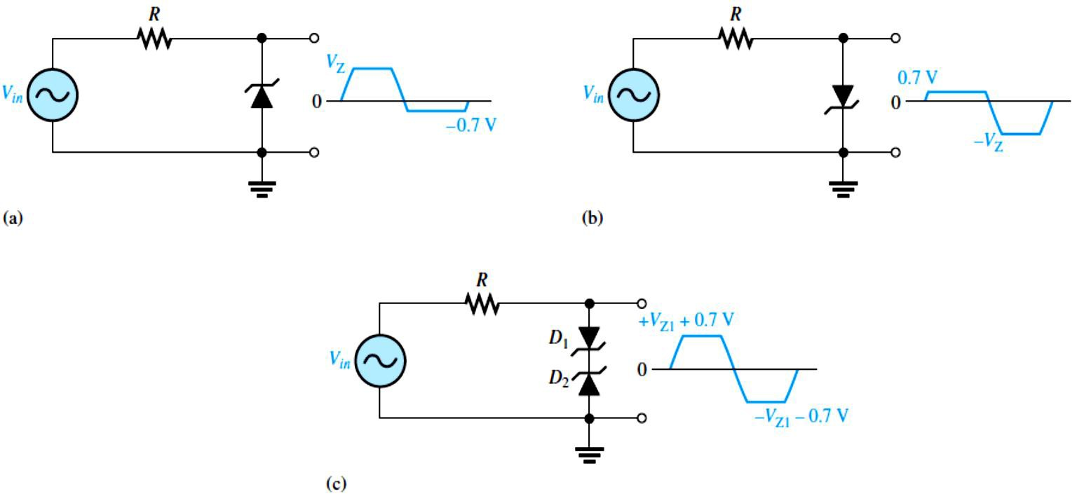
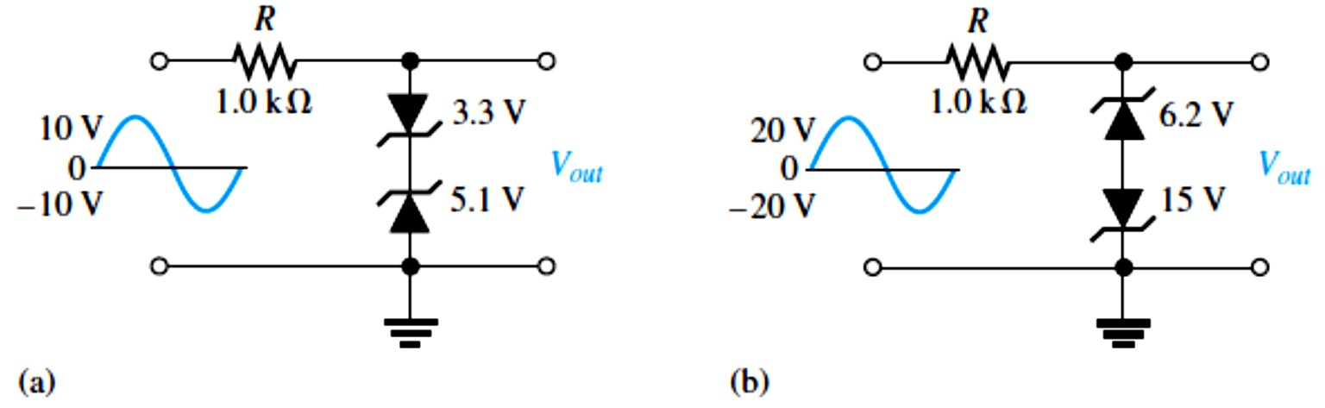
𝐼_{Z(max)} = 𝐼_{T} = (�_{IN} − �_{Z})⁄𝑅= (24 V − 12 V)⁄470 Ω = 25.5 mA
If 𝑅� is removed from the circuit, the load current is 0 A. Since 𝐼_{Z(max)} is less than 𝐼_{ZM}, 0 A is an acceptable minimum value for 𝐼_{L} because the zener can handle all of the 25.5 mA.
^{𝐼}�(min) ^{= 0 A}
The maximum value of 𝐼_{L} occurs when 𝐼_{Z} is minimum (𝐼_{Z} = 𝐼_{ZK}), so
𝐼_{�(max)} = 𝐼_{T} − 𝐼_{ZK} = 25.5 mA − 1 mA = 24.5 mA
The minimum value of 𝑅� is
^{𝑅}�(min) ⁼ _{𝐼}
�_{Z}
12 V
= = 490 Ω
24.5 mA
�(max)
Therefore, if 𝑅� is less than 490 Ω, 𝑅� will draw more of the total current away from the zener and 𝐼_{Z} will be reduced below 𝐼_{ZK}. This will cause the zener to lose regulation. Regulation is maintained for any value of 𝑅� between 490 Ω and infinity.
Zener Limiter: In addition to voltage regulation applications, zener diodes can be used in ac applications to limit voltage swings to desired levels, as shown in Figure 3-7.
FIGURE 3-7: Basic zener limiting action with a sinusoidal input voltage.
EXAMPLE 3–8: Determine the output voltage for each zener limiting circuit in Figure 3-8.
FIGURE 3-8

Slide 6
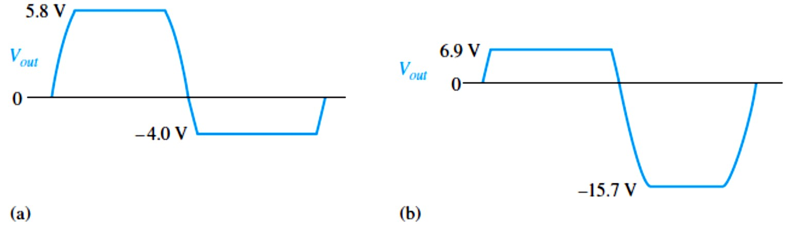

Solution See Figure 3-9 for the resulting output voltages. Remember, when one zener is operating in breakdown, the other one is forward-biased with approximately 0.7 V across it.
FIGURE 3-9
3.3 The Varactor Diode
A varactor diode also referred to as varicap or tuning diode, shown in Figure 3-10, acts as a variable capacitor under reverse-bias conditions and is doped to maximize the inherent capacitance of the depletion region.
The capacitance of a varactor varies inversely with reverse-bias voltage.
  The capacitance (𝐶) is determined by the parameters of plate area (A), dielectric constant (𝜖), and plate separation (d), as expressed in the following formula:
𝐴�
𝐶=
𝑑
As the reverse-bias voltage increases, the depletion region widens, effectively increasing the plate separation, thus decreasing the capacitance.
When the reverse-bias voltage decreases, the depletion region narrows, thus increasing the capacitance.
Varactor diodes are commonly used in communication systems: VHF, UHF, parallel
resonant circuit, cellular communications and satellite receivers.
FIGURE 3-10: Varactor diode symbol.
3.4 Optical Diodes
In this section, three types of optoelectronic devices are introduced: the light-emitting diode, quantum dots, and the photodiode.
The light-emitting diode (LED), as shown in Figure 3-11, emits light when forward-biased.
LEDs are available for either infrared (IR) or visible light.
High-intensity LEDs are used in large-screen displays, traffic lights, automotive lighting, and home lighting.
An organic LED (OLED) uses two or three layers of organic material (organic molecules or polymers) to produce light.

Slide 7

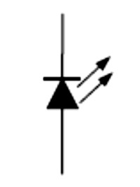
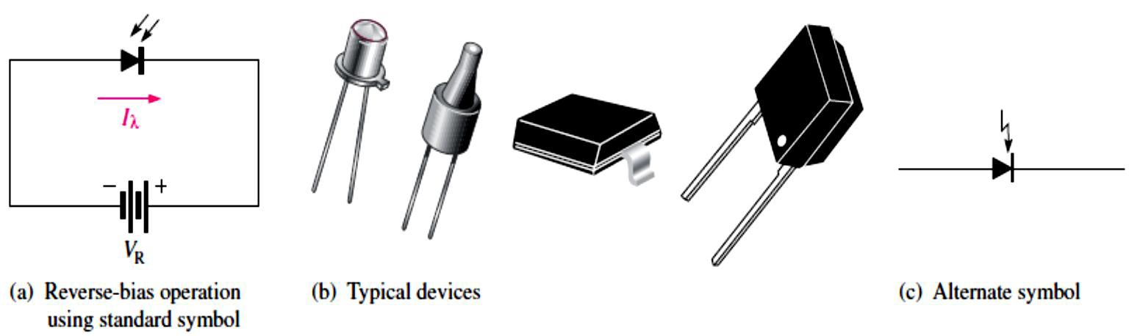
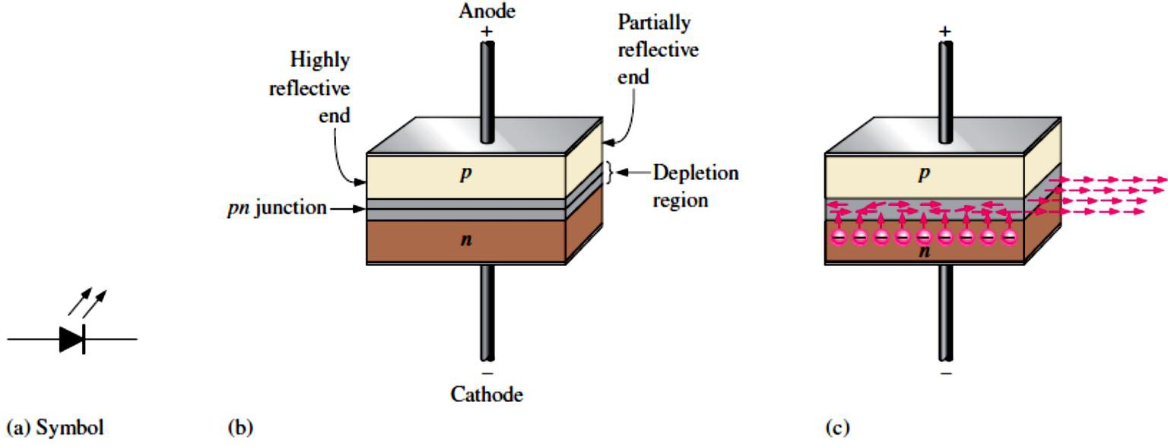
Quantum dots are semiconductor devices that emit light when energized from an external source.
The photodiode, as shown in Figure 3-12, is a device that operates in reverse bias and exhibits an increase in reverse current with light intensity.
On the other hand, the photodiode is a light detector.
FIGURE 3-11: Symbol for an LED.
FIGURE 3-12: Photodiode.
3.5 Other Types of Diodes
The Laser Diode, as shown in Figure 3-13, is similar to an LED except that it emits coherent (single wavelength) light when the forward current exceeds a threshold value.
FIGURE 3-13: Basic laser diode construction and operation.

Slide 8
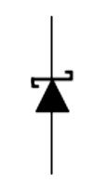
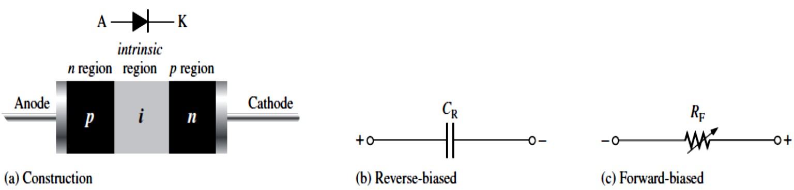
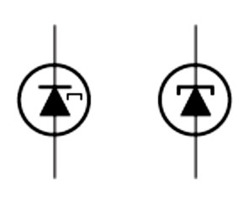
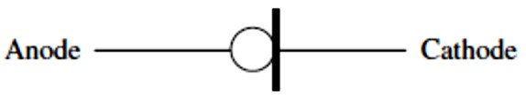
The Schottky Diode also known as hot-carrier diodes, as is shown in Figure 3-14, has a metal- to-semiconductor junction. It is high-current diodes used primarily in high-frequency and fast- switching applications.
FIGURE 3-14: Schottky diode symbol.
The PIN Diode, as shown in Figure 3-15, has a p region, an n region, and an intrinsic (i) region and displays a variable resistance characteristic when forward-biased and a constant capacitance when reverse-biased.
FIGURE 3-15: PIN diode.
The Step-Recovery Diode uses graded doping where the doping level of the semiconductive materials is reduced as the pn junction is approached.
  This produces an abrupt turn-off time by allowing a fast release of stored charge when switching from forward to reverse bias. It also allows a rapid re-establishment of forward
current when switching from reverse to forward bias.
  This diode is used in very high frequency (VHF) and fast-switching applications.
The Tunnel Diode exhibits a special characteristic known as negative resistance.
  This feature makes it useful in oscillator and microwave amplifier applications. Two alternate symbols are shown in Figure 3-16.
FIGURE 3-16: Tunnel diode symbols.
Current Regulator Diode is often referred to as a constant-current diode. Rather than maintaining a constant voltage, as the zener diode does, this diode maintains a constant current. The symbol is shown in Figure 3-17.
FIGURE 3-17: Symbol for a current regulator diode.

